Slide 1

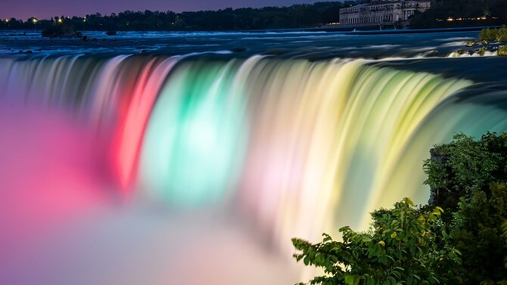
Summer Camp in Canada
with
WORLD LIFE EDUCATION CENTRE
世界生命教育中心加拿大夏令营
Explore More!
Let’s escape the ordinary and learn while being free!
World Life Education Centre would like to Welcome and Host you through an enriching and immersive educational and culturally rich experience. Make new friends who share your passions and grow your confidence as you enjoy conquering new challenges together.
CONTACT US:
E: admin@worldlifeedu.ca
T: +1 (416 – 219 – 4748)
WeChat ID: WLEC-Canada
www.worldlifeedu.ca
Insta: @worldlifeeduca
LET’S BEGIN YOUR CULTURAL STUDY TOUR!

Slide 2
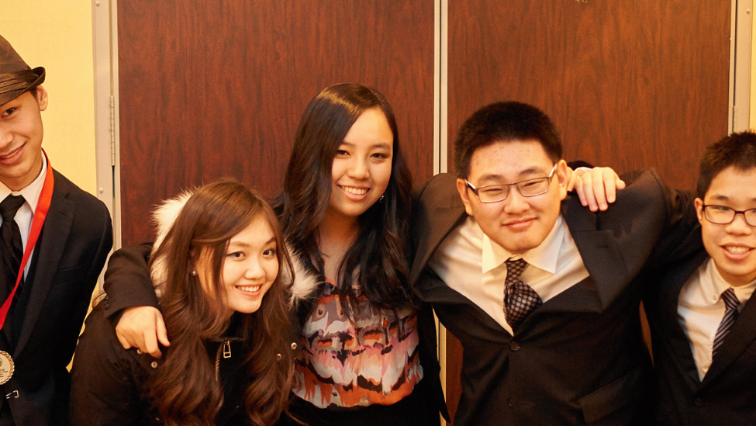
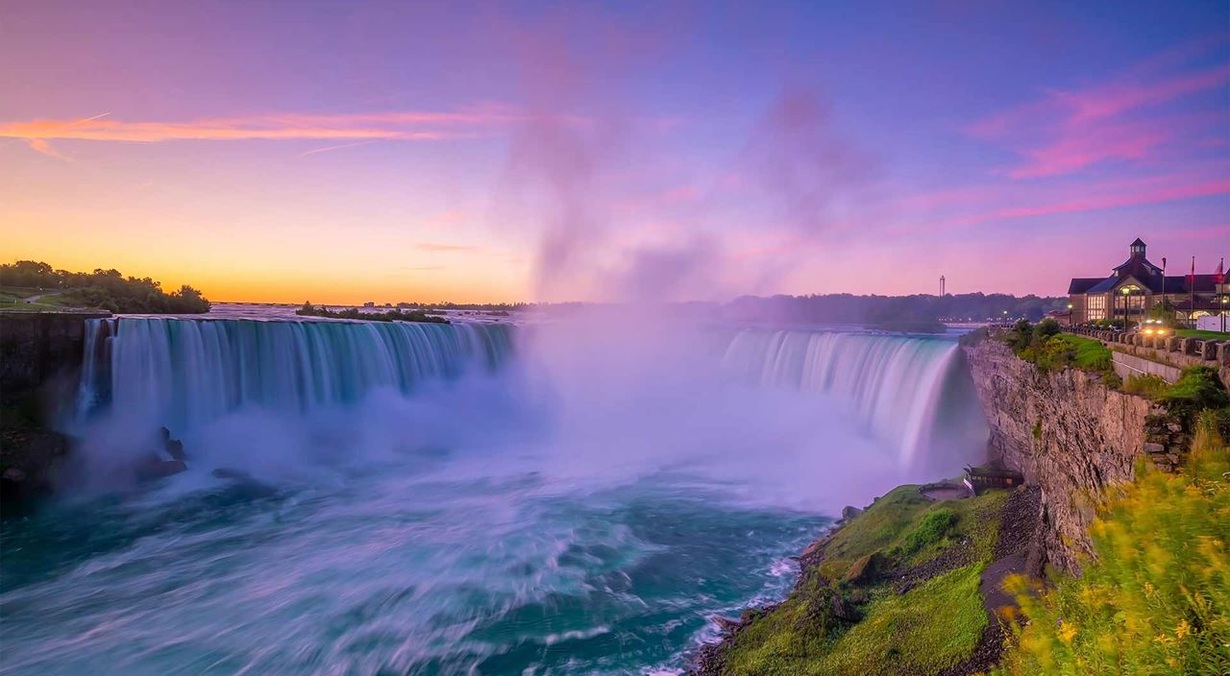
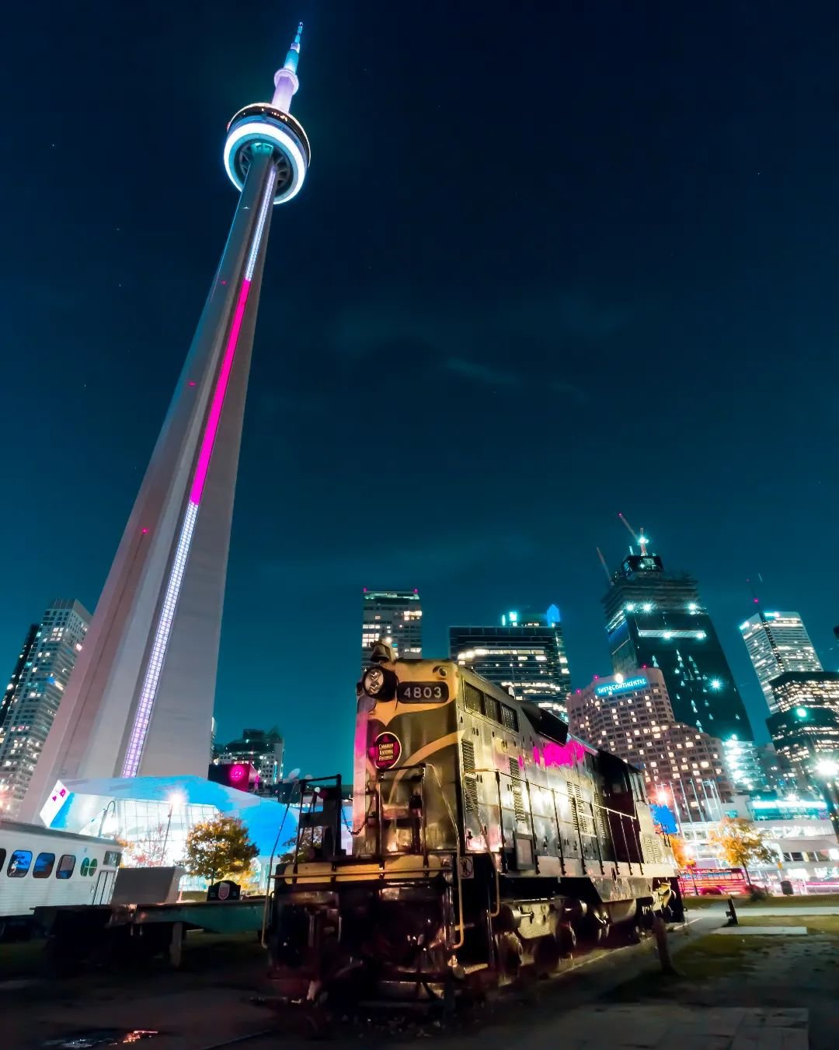
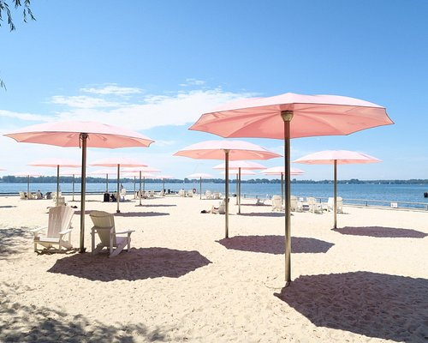
WORLD LIFE HIGH SCHOOL
SUMMER CAMP IN CANADA
SUMMER ENRICHMENT AND STUDY TOUR PROGRAM.
Additional or optional trips will include visits to
CN Tower, Toronto Islands, Toronto Aquarium, Royal Ontario Museum, The Beaches, Niagara Falls, Montreal, Ottawa, Kingston and much more!
This program welcomes students from around the world, who are preparing for secondary or post-secondary studies (ages 13 to 40 years old) to enjoy a fun and positive learning experience.
Weekly focused teaching will integrate literacy skills and foster the development of verbal and written communication skills.
Activities will help improve language skills through creative writing, visual arts, photography, theatre, sports and cultural tours of Toronto. Each week, a distinct area of interest will be explored whilst incorporating a variety of exciting and interactive activities, classes and workshops.
Niagara Falls
CN Tower
Sugar Beach

Slide 3
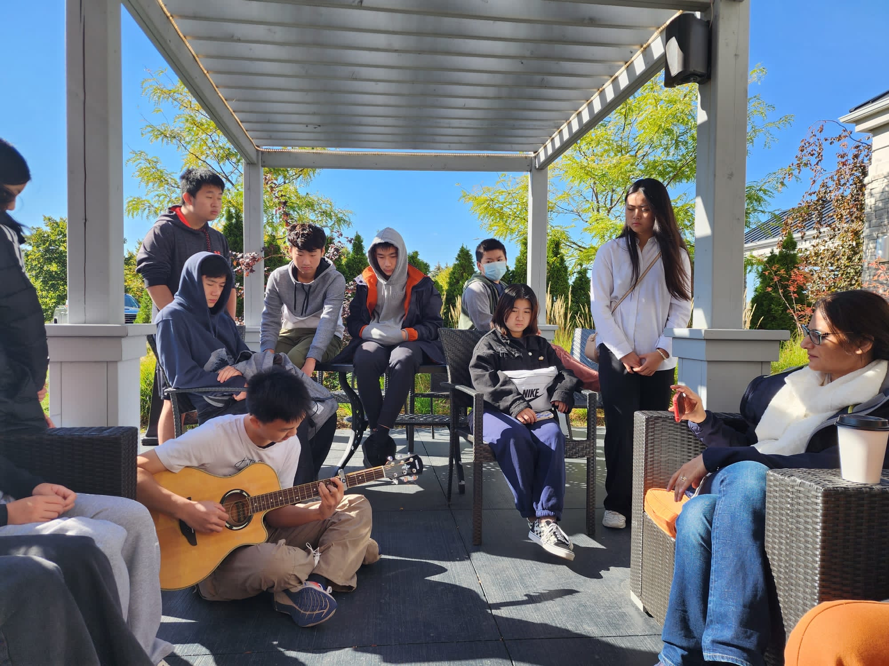


PROGRAM DETAILS
WHERE: CANADA
WHEN: July 15th to August 15th OR AUGUST 1ST TO AUGUST 31ST 2024
Monday | Tuesday | Wednesday | Thursday | Friday
9 - 12 | 9 - 12 | 9 - 12 | 9 - 12 | 9 - 12
12 - 1 | 12 - 1 | 12 - 1 | 12 - 1 | 12 - 1
1 - 3 | 1 - 3 | 1 - 3 | 1 - 3 | 1 - 3 Tours
Private Optional Classes | Private Optional Classes | Private Optional Classes | Private Optional Classes | Activities
Activities | Activities | Activities | Activities | Talks
100 Hours of English Language Training
Choices of trips to different Cities
Visit Top landmark destinations
University Tours
Experience Canada’s true North culture
Homestay experience independently
Canadian cultural experience with Native language speakers
Afternoon activities
Flight tickets
Visas
Insurance
Seminars and talks on your Future
Career exploration and education options in Canada
Free consultation and advising

Slide 4

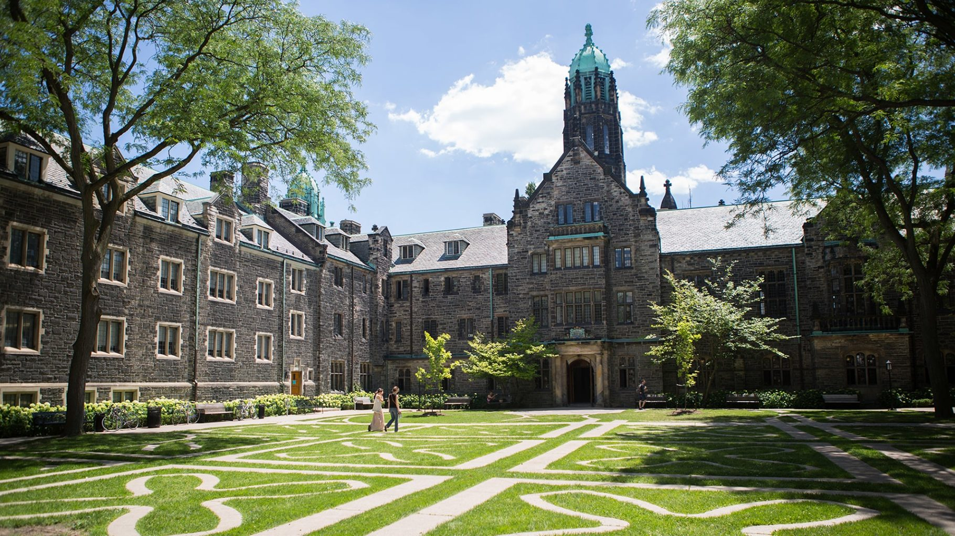
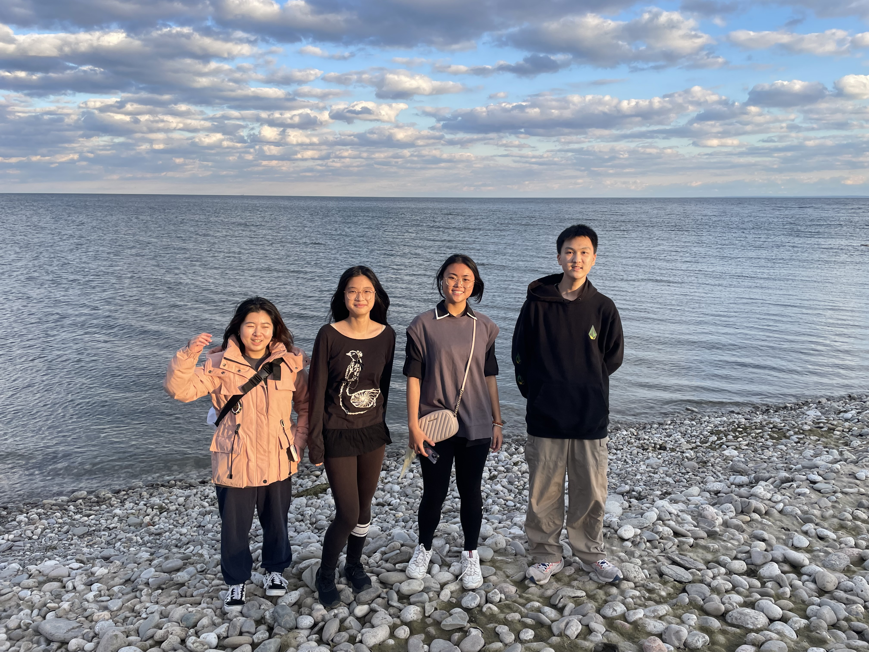
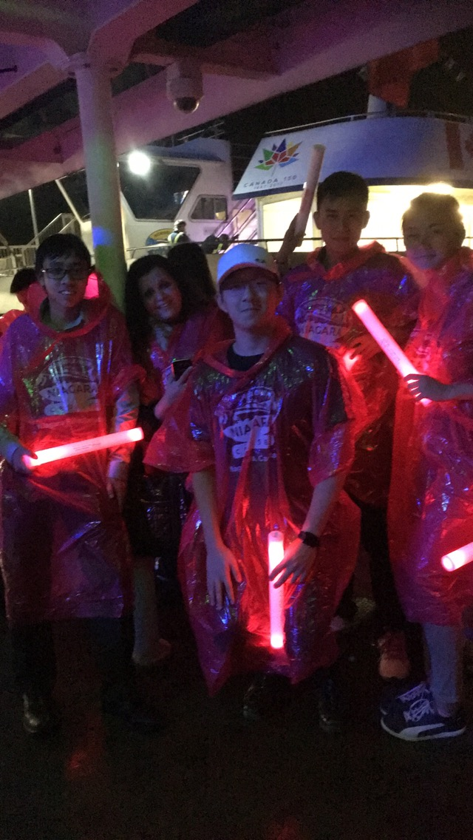
Learn more and educate yourself about your Canadian Future in 2 Months or Less!
TMU
Get your timetable made today!
CN Tower
UFT
Monday to Friday – 10am to 4pm
Language studies (ESL), SSAT, SAT, IELTS
We also offer High School Credit Courses and Junior Public Speaking programs for Local Students.
Camp Activities
Friday to Sunday – Trips and Activities
For more details, please refer to next page.
Principal +1 416 219 4748
www.worldlifeedu.ca
Lakeside Park
Niagara Falls

Slide 5
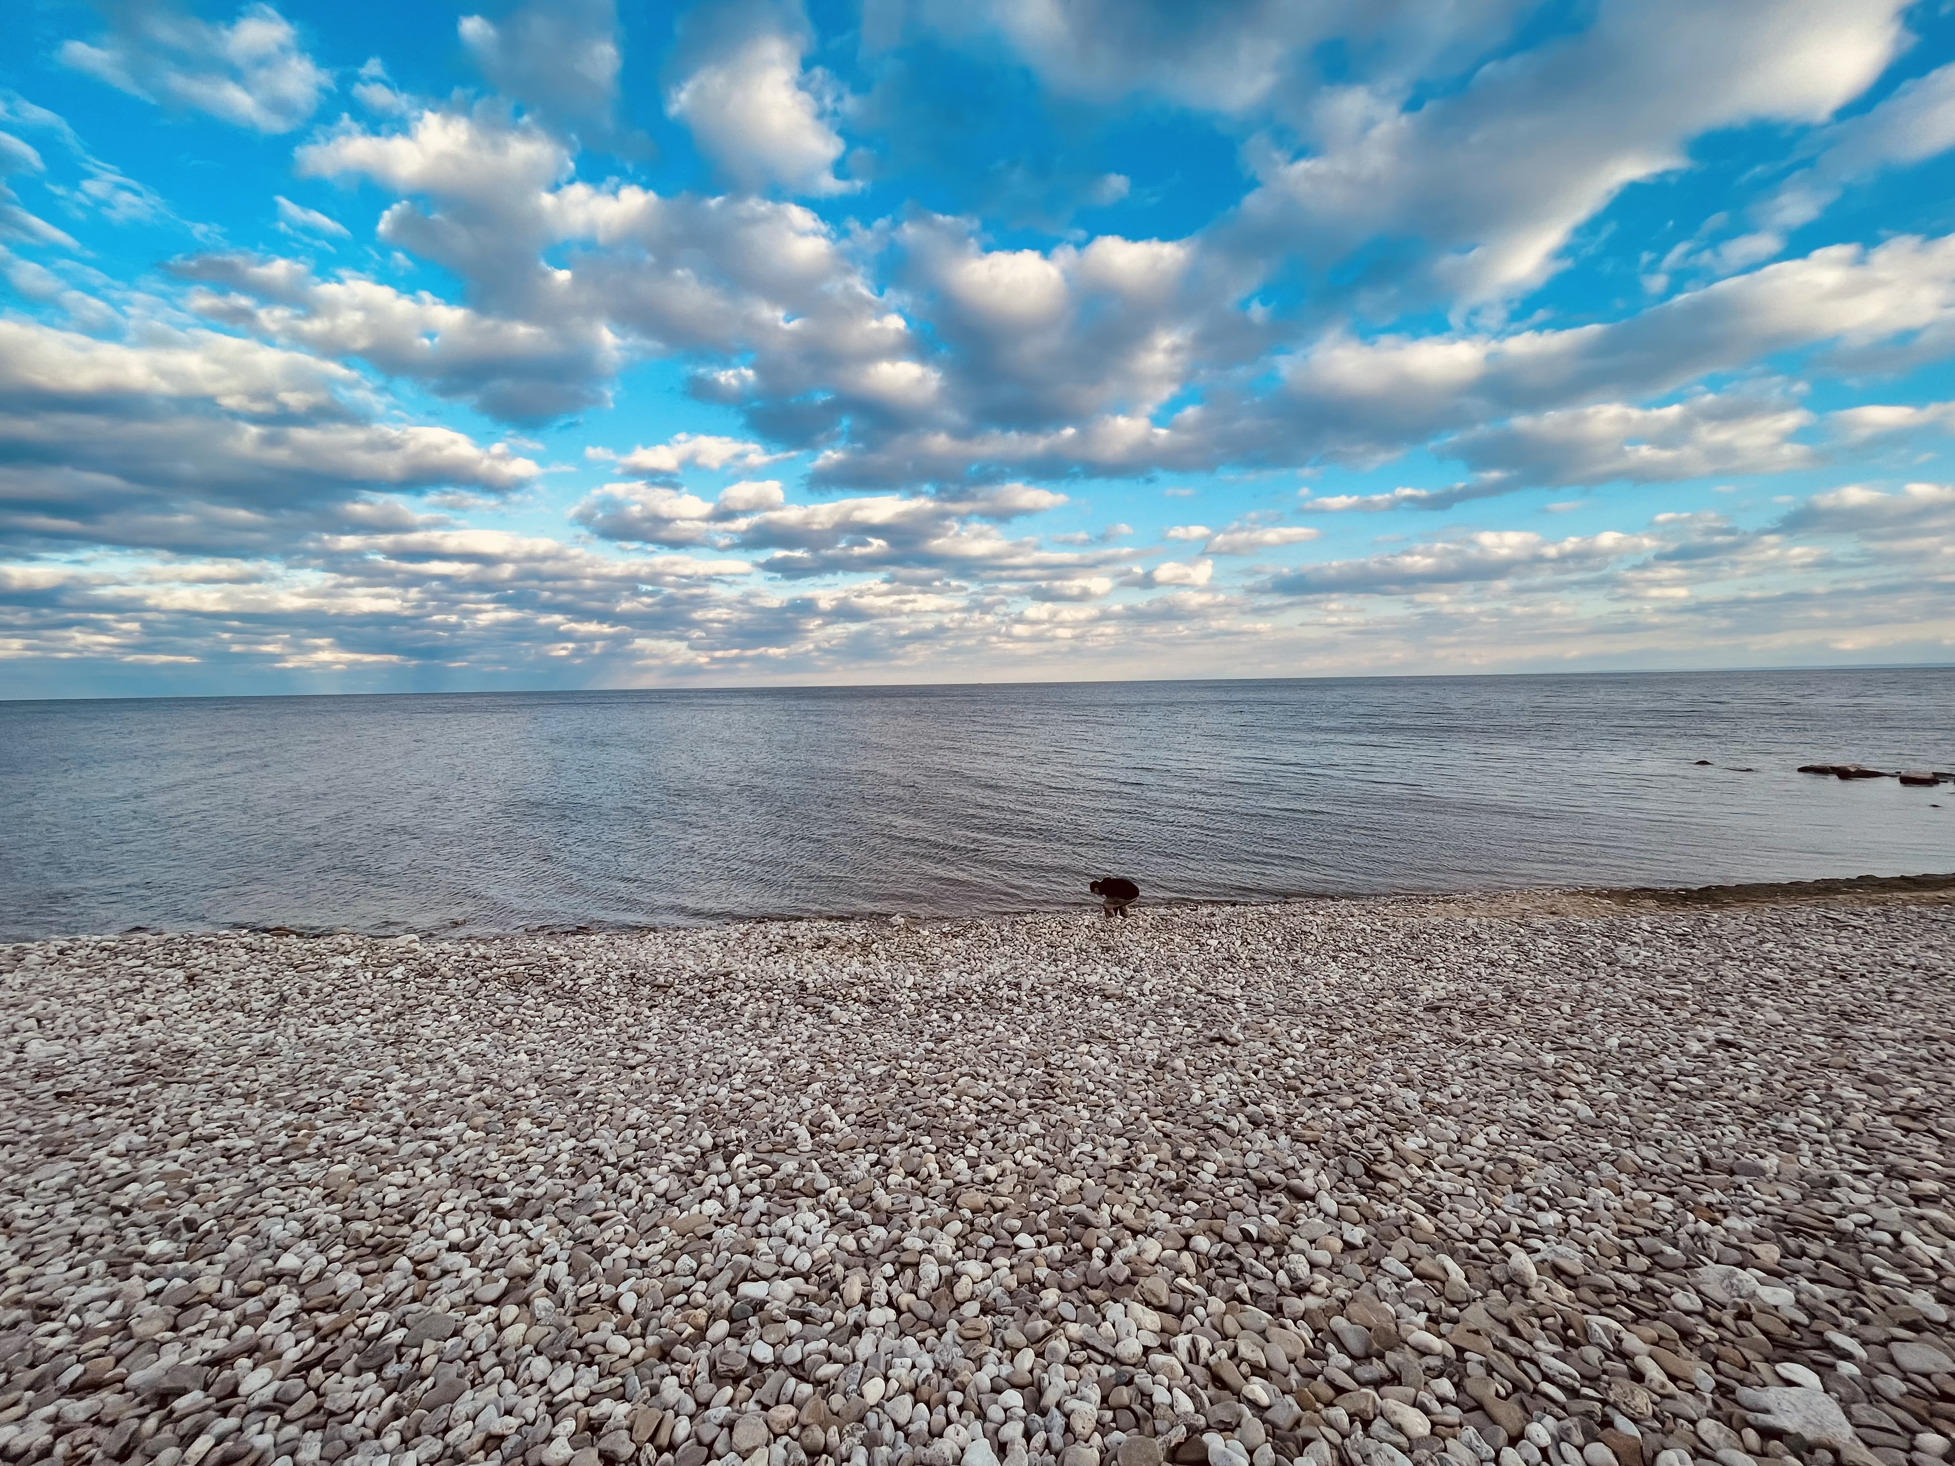

CULTURALLY IMMERSIVE COURSES
SUMMER ENRICHMENT AND STUDY TOUR PROGRAM
FRIENDLY ENVIRONMENT
WORLD LIFE HIGH SCHOOL
Make the most important decision of your life in your comfort zone.
VISA
SERVICES
$8000 CAD – 4 WEEKS /Int
$1400 CAD – VISA – STUDY PERMIT & INSURANCE
$2100 CAD – HOMESTAY
$5100 CAD - ONE CHAPERONE FEE
$500 CAD - REFUNDABLE DEPOSIT
MEALS, PERSONAL AND SHOPPING EXPENSES INCLUDED
SHORT TERM STUDENTS (STUDYING FOR 6 MONTHS OR LESS)
Our representative can do the paperwork for the visas.
VISA SERVICES AVAILABLE
AIRPORT PICK UP AND DROP
HOMESTAY SERVICES PROVIDED
ESL CULTURAL AND STUDY TOUR
WEEKEND VISITS TO TOP UNIVERSITIES!
TRIPS: NIAGARA FALLS, 1000 ISLAND, PARLIAMENT HILL, MUSEUMS, CN TOWER AND MUCH MORE!
www.worldlifeedu.ca
@worldlifeeduca

Slide 6
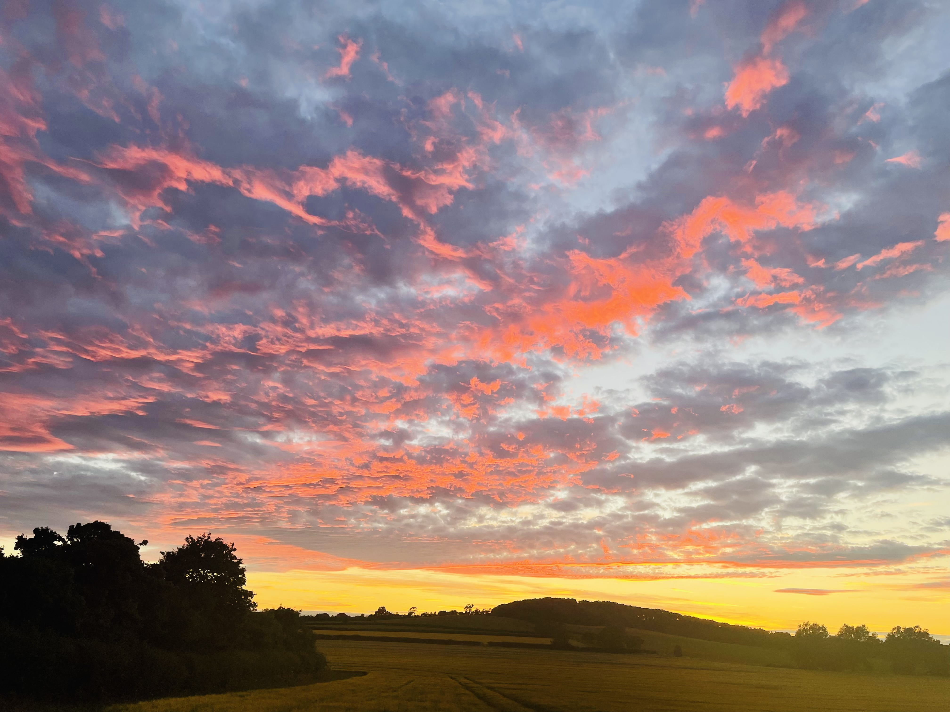
Join Us
SUMMER OF 2025
MAKING LASTING CONNECTIONS WITH TEACHERS AND STUDENTS
Make informed decisions as you assess and understand your future Academic and career options, as ‘Knowledge is Power’. We will equip you with the knowledge of Educational opportunities to be availed, as you travel and experience everything Canada has to offer!
AMENITIES
Complementary WiFi Internet Access throughout Home Stay
Meals Included
CONTACT US:
E: admin@worldlifeedu.ca
T: +1 (416 – 219 – 4748)
WeChat ID: WLEC2012
www.worldlifeedu.ca
Insta: @worldlifeeduca
REGISTRATION IS NOW OPEN!
FOR CORRESPONDANCE IN CHINESE, PLEASE CONTACT CHRISTINE.
WeChat ID – christine_wrh8866– Certificate will be Awarded to All.

